Slide 1
Group 5
Kyle Bodin, George Croucher, Luke Coates, Viktor Bonev

Slide 2
Sumo Brief
Single Player Game
Consider a Genre
Remove a main mechanic
Replace removed mechanic
Emphasis on a single mechanic

Slide 3
Response to the Brief
3D Platformer – Linear – First person view
Substituted the movement set – Grapple Movement
Added timer – Frustration
Simple learn master practice loop

Slide 4
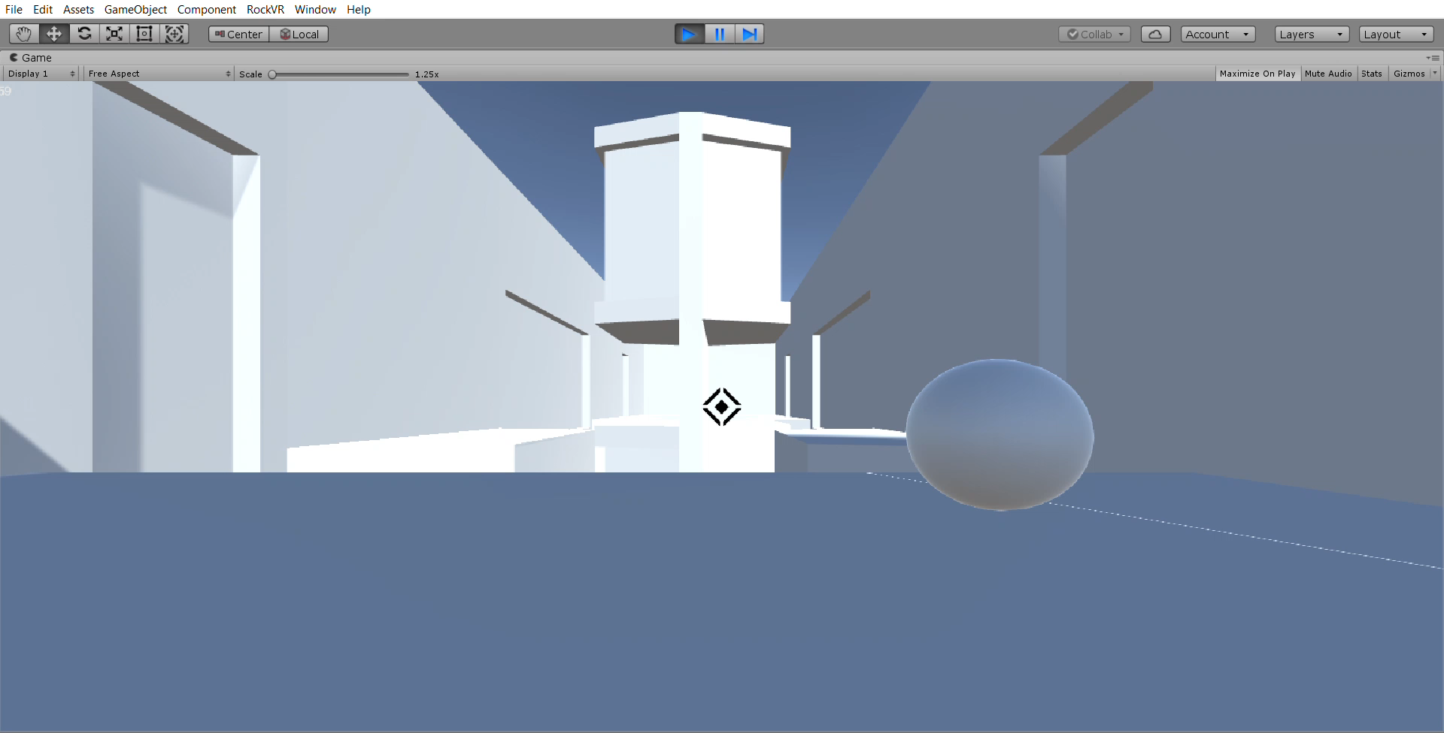
Video

Slide 5
Deliverables
Assets fully implemented
Audio
Art
Models
9 Levels changing in difficulty
3 levels with movement
3 levels with environmental hazards
3 Levels combining the above
Playtesting - Refining the flow & core loop

Slide 6
Any Questions?

